Slide 1


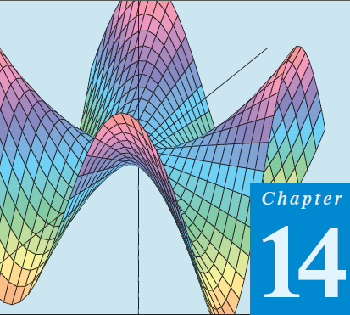
Thomas Calculus 11th
07
Lagrange Multipliers
Samuel Lukas

Slide 2


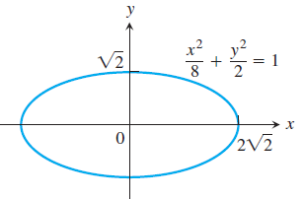
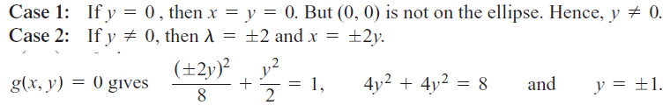
Lagrange Multipliers
Example :

Slide 3
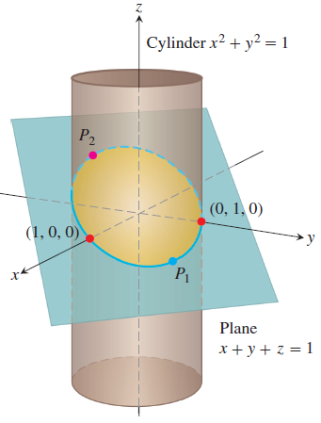
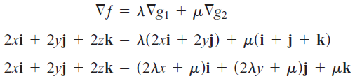

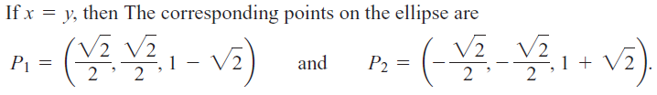
The points on the ellipse closest to the origin are (1, 0, 0) and (0, 1, 0). The point on
the ellipse farthest from the origin is P₂.

Slide 4


Exercises 1

Slide 5





